Slide 1
Shared IT Services DevOps transformation ECOSYSTEM track kick off session 21st of June 2017

Slide 2
Purpose of the meeting and agenda
The purpose of this Devops Eko system kick-off session is to :
introduce DevOps concept
present the high level structure of DevOps change initiative with a focus on „ecosystem track”
discuss our expectations and way forward for „ecosystem track”

Slide 3
what is DevOps ?

Slide 4
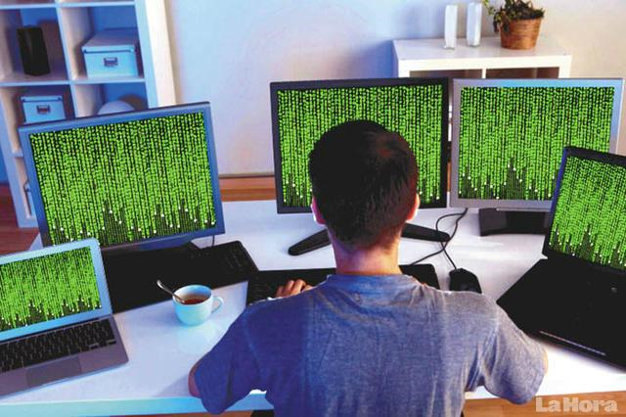
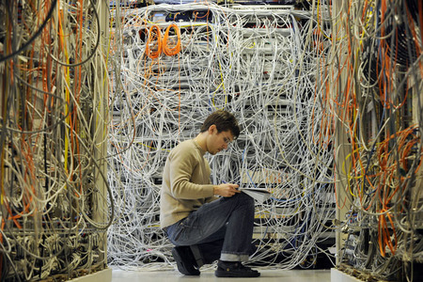
Our application is growing, we need a new server ASAP!
Ok... But its going to take some time to sort this out.
<DEV>
{OR}
OPS
Notes:
Most of you probably are familiar with the classic IT issues like ordering a new server?
It takes some time right?
And there is a lot of blame game.
Who is guilty dev or ops?

Slide 5


We need new feature to be deployed on Prod ASAP!
No! It finally works fine after last release.
<DEV>
{OR}
OPS
Notes:
Get new feature of application deployed on production may be also not so easy☺
Blame game again.
Ops are perceived as resistant to change, slowing down the deployment…
Is this right perception?

Slide 6
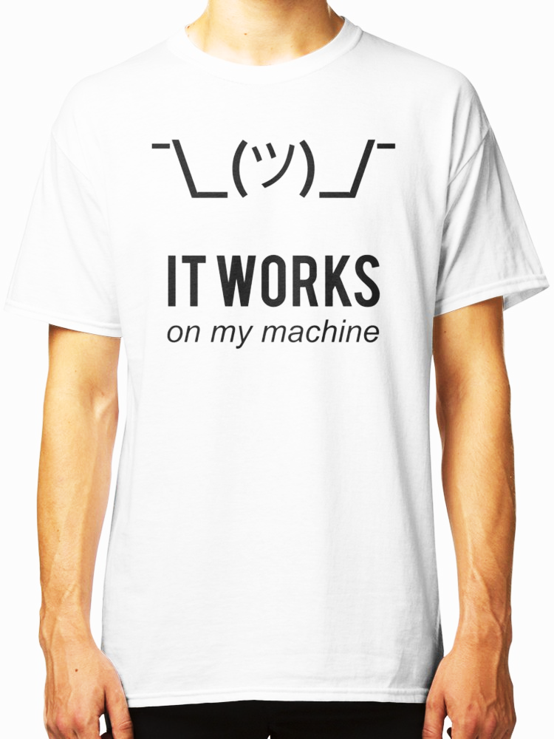
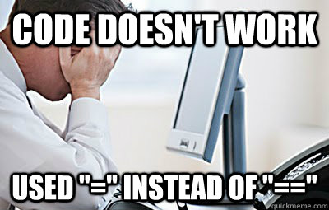
<DEV>
{OR}
OPS
Notes:
And the classic one☺
Where does the problem lie? on a code or infrastructure?. On Dev side or Ops side?
Example with monitoring tools which in most cases are not well fit to every application.
Example with not the same testing environments.

Slide 7
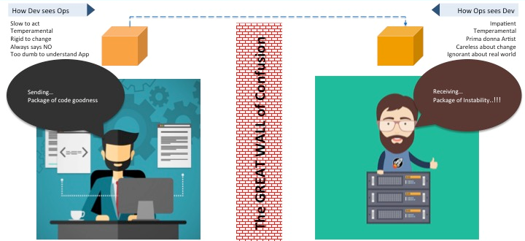
<DEV>
{OR}
OPS
Wall of confusion
Developer priorities
Operational priorites
Create a change
Add or modify Feature
Create stability
Create or enhance services
Notes:
All those real life examples leads us to understanding the issue.
Wall of confusion which represents different priories and goals of Dev and Ops. So who is responsible for the issues between Dev and Ops?
Developer who wants to create more and more cool features?
Operation guy who tries to maintain stable environment?
The answer you know already
No one. Their just doing their job and in most cases don’t see that the goal is actually the same. Happy customer.
And what is solution for the issue?
DevOps

Slide 8
What is DevOps ?
DevOps
Lean
&
Agile
Culture
Process
Automation
People
Technology
Notes:
DevOps is a cultural shift and collaboration (between development, operations and testing) and there is no single DevOps tool. It is rather a set (or "DevOps toolchain") consisting of multiple tools.
DevOps tools fit into one or more of the below categories which is reflective of key aspects of the software development and delivery process.

Slide 9
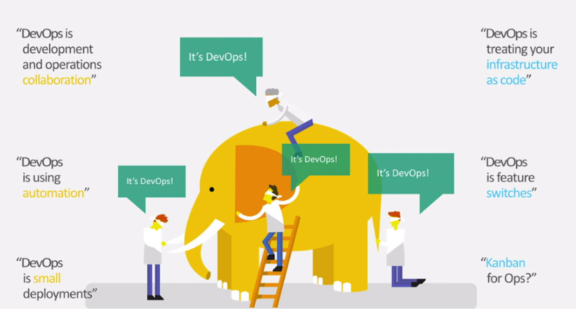

Slide 10
More information and training
Please familiarize yourself with the material!
DevOps: The Big Picture
https://app.pluralsight.com/library/courses/devops-big-picture/table-of-contents
Implementing DevOps in the Real World
https://app.pluralsight.com/library/courses/implementing-devops-real-world/table-of-contents
DevOps 2017 conference in Helsinki
https://devops.com/

Slide 11
DevOps change initiative

Slide 12

DevOps transformation initiave is now started by DRS organization
Notes:
managed by Evelien Deman (CPM)

Slide 13
Devops change initiative
DevOps CoE – Katarzyna Wojcik
DevOps pilots – Marcin Klimkiewicz
DevOps ecosystem – Evelien Deman
DevOps technology & tools – Bartosz Celmer
DevOps change management/communication (incl. Training material) – Evelien Deman
Overall coordination by Evelien Deman

Slide 14

DevOps transformation first steps - PILOTS
Our current focus is to transform selected teams from regular development practices to DevOps methods.
This would help us to understand how DevOps concept can be useful for Group IT.
Desired state after pilot project – team proud to say I’m DevOps!
Increased team engagement
Better product quality and more reliable releases
Shorter lead times

Slide 15
Pilots and „ecosystem track” connection
Pilot transformations will be driven by the teams and their Team Leaders
Pilot transformations will be supported by DRS representatives (including present VPS4IT coaches)
We plan regular reviews of the pilot findings and learnings with you through the DRS support network

Slide 16
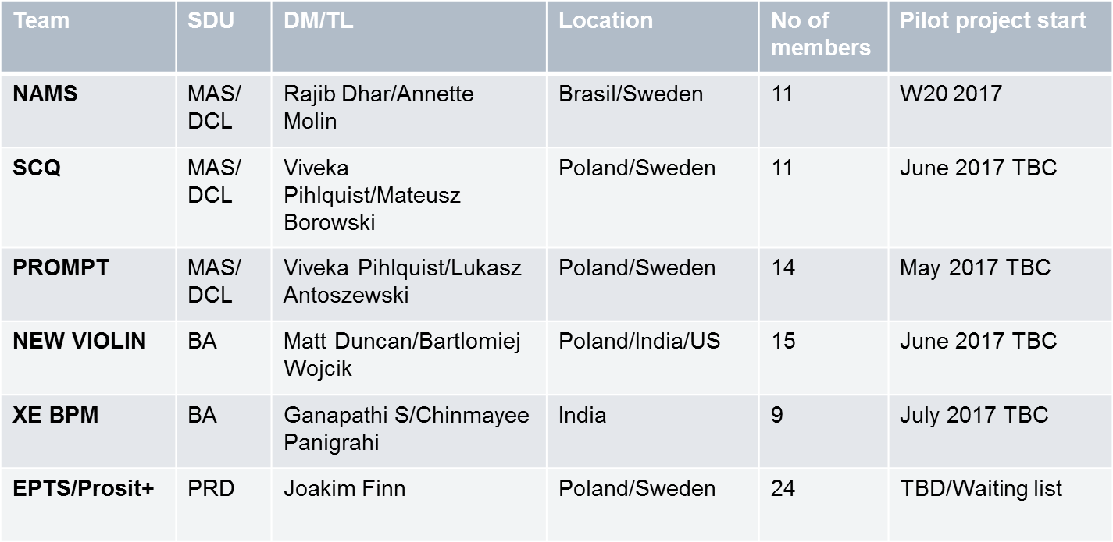
Who are the pilots ?
2017 target is to transform 5 teams and learn about DevOps as much as possible in order to be able to design and execute the change project for Volvo Group IT
Notes:
As it has been said we have 5 pilot teams.
Together with experts in DevOps implementations from Eficode company as mentioned before we are running pilots in accrodence with presented on slide schedule.
This Finish company shares with us their understanding of relevant competences, methodologies and tools they use in their ongoing chalanges to become a better service provider and trusted partner in the digital world.
When it comes to specific teams involved in DEvOps pilots let’s start with:
NAMS – New Aftermarket Servicies. NAMS is a common access point for diagnostic aftermarket systems, products or tools to Volvo central systems for access of data and services. This pilot is most advanced one. Prestudy is finalized, and now awaiting the report on findings and based on report input we will outline plan for next steps
Next is SCQ –VTC - Data repository for dealers. trucks and sales)
Contract Quotation Online is a system used in the Truck sales and after sales process for the service contract quotes, including the creation of the service contract documents. Prestudy planned end of June, beginning of July
PROMPT Global Web application for creating and maintaining service plans. Optimise scheduling for service in order to increase uptime. Prestudy planned end of June, beginning of July
NEW VIOLIN - New intranet platform including news publishing tool prestudy planned end of June, beginning of July
XE BPM – team that mainly takes care of VGMS .In the pilots included but not planned yet
Our Intention of presenting pilot’s teams was familiaze you who are the pilots and where we are at this moment with activities.

Slide 17
DevOps „ecosystem track”

Slide 18

Devops Change Initiative
DevOps CoE – Katarzyna Wojcik
DevOps pilots – Marcin Klimkiewicz
DevOps ecosystem – Evelien Deman
DevOps technology & tools – Bartosz Celmer
DevOps change management/communication (incl. Training material) – Evelien Deman

Slide 19


Devops Ecosystem Track: two main subdeliverables
Your participation
Implementing Devops ways of working on some or our development teams, will need adaptations of some of our IT Directives, Processes, Methods and Frameworks.
Ambition: Secure existing materials are devops compatible
There is a need to secure that people understand what minimum ingredients they need to think of, and how to combine them, when doing “devops way”
.
Ambition: Show the devops way
For your information

Slide 20

Adaptions IT directives, Processes, Methods and Frameworks.
Current directives process, methods & frameorks
Implementing Devops ways of working on some or our development teams, will need adaptations of some of our IT Directives, Processes, Methods and Frameworks.
Inventory
approach
Assessment
decission
Implementation
Devops coherent directives process, methods & frameorks

Slide 21
Inventory
Status: done
Baseline inventory is done based on the work done for the methods review
SMEs identified
Inventory of affected documents is expected to evolve over time (new/obsolete/..) -> iterative!

Slide 22

Assessment
Status: starting now
Assessment will serve as decission material for the next phase of planning and implementation of changes to the methods/frameworks/directives/process
Will be done by the method/framework/directive sme (=you)
Approach explained in the kickof 21/6 (=today)
SME will be informed regarding devops, both on “market” devops & what devops means for volvo.
Assessment is expected to evolve over time as we gather more knowledge (iterative process)
Start of with a simple assessment containing 2 ratings & 2 corresponding explanations
kickoff
Understand market devops
Do first assessment
DUE DATE: 30/6
Understand
Pilot results
Update assessement
SME actions

Slide 23
4 Simple Assessment questions <name of process/method/framework/directive>
What is the effort to revisit? High/medium/low/n.a.
Explain your rating for the above
What is the change effort for the organisation? High/medium/low
Explain your rating for the above
Assesment can be found on : http://teamplace.volvo.com/sites/DevOps/5%20DevOps%20ekosystem/Forms/AllItems.aspx
Due date: 30/6

Slide 24
Example of the summary Assessment
What | Effort to revist | Explanation | Change effort for the organisation | Explanation
ADF.... | high | Total document needs to be revisted and might be obsolote | high | Lot of stakeholdersneed to work in a completely different way
Project Handbook | medium |  | low | Only Projectmgr, can be part of normal release process
SMD
....
No real answers!!!!!!

Slide 25



How to get to ‘know devops’?
Familiarize yourself with the devops “market” knowledge
2
Attend the Devops-Pilot travel Journal sessions
1

Slide 26
Familiarize yourself with the “devops market knowledge”
1
DevOps: The Big Picture
https://app.pluralsight.com/library/courses/devops-big-picture/table-of-contents
Implementing DevOps in the Real World
https://app.pluralsight.com/library/courses/implementing-devops-real-world/table-of-contents
DevOps 2017 conference in Helsinki
https://devops.com/

Slide 27

Pilot Travel Journal sessions
2
When: After/during each pilot. Invitations will follow
Moderated: by one of the Pilot Travellers (drs members)
Purpose: improve SME’s understanding of the impact of devops for their area

Slide 28




Summary of the assessment :Iterative approach
2017
First assessement due: 30/6
Possible updates based on improved understanding during our devlops journey

Slide 29


